Slide 1

STELLA OBASANJO HOSPITAL Edo state ministry of Health
SOH RECALIBRATION COST
TANIT MEDICAL ENGINEERING
TANIT MEDICAL ENGINEERING January 2023

Slide 2
Summary
The entire project (OPD, IPD, Administrative block & Mortuary) of the SOH for ease of execution has been suggestively broken done into 4 options.
Option 1
Option 2
Option 3
Option 4
Included
OPD
IPD
MORTUARY
Excluded
ADMINISTRATIVE BLOCK
Included
OPD
IPD
Diagnostics
Dialysis
IVF
ER
Medical gases
MORTUARY
Excluded
ADMINISTRATIVE BLOCK
Portions of IPD
Included
OPD
IPD
Diagnostics
Dialysis
IVF
ER
Medical gases
Excluded
ADMINISTRATIVE BLOCK
Portions of IPD
MORTUARY
Included
OPD
IPD
Diagnostics
Dialysis
IVF
ER
Excluded
ADMINISTRATIVE BLOCK
Portions of IPD
Medical gases
MORTUARY
TANIT MEDICAL ENGINEERING
TANIT MEDICAL ENGINEERING January 2023

Slide 3
Financials
FULL PROJECT
(WITH ADMINISTRATIVE BLOCK)
₦18,509,626,266.76
OPTIONS | SCENARIO TOTAL SUM (₦) | DIFFERENCE (₦) | SCENARIO COVERAGE AREAS
OPTION 1 | 14,909,802,833.20 | 3,599,823,433.56 | OPD,IPD,MORTUARY , BUT EXCLUDING ADMINISTRATIVE BLOCK
OPTION 2 | 10,000,734,122.80 | 8,508,892,143.96 | OPD,IPD(DIAGNOSTIC,DIALYSIS,IVF, ER AND MEDICAL GASES),MORTUARY , BUT EXCLUDING ADMINISTRATIVE BLOCK AND ALL OTHER PORTIONS OF IPD
OPTION 3 | 8,754,842,710.28 | 9,754,783,556.48 | OPD,IPD(DIAGNOSTIC, ER AND MEDICAL GASES),MORTUARY , BUT EXCLUDING ADMINISTRATIVE BLOCK , ALL OTHER PORTIONS OF IPD, AND MORTUARY
OPTION 4 | 8,564,321,711.46 | 9,945,304,555.30 | OPD,IPD(DIAGNOSTIC,DIALYSIS,IVF, AND ER),MORTUARY , BUT EXCLUDING ADMINISTRATIVE BLOCK , ALL OTHER PORTIONS OF IPD, MORTUARY, AND MEDICAL GASES
Phase
TANIT MEDICAL ENGINEERING
TANIT MEDICAL ENGINEERING January 2023

Slide 4
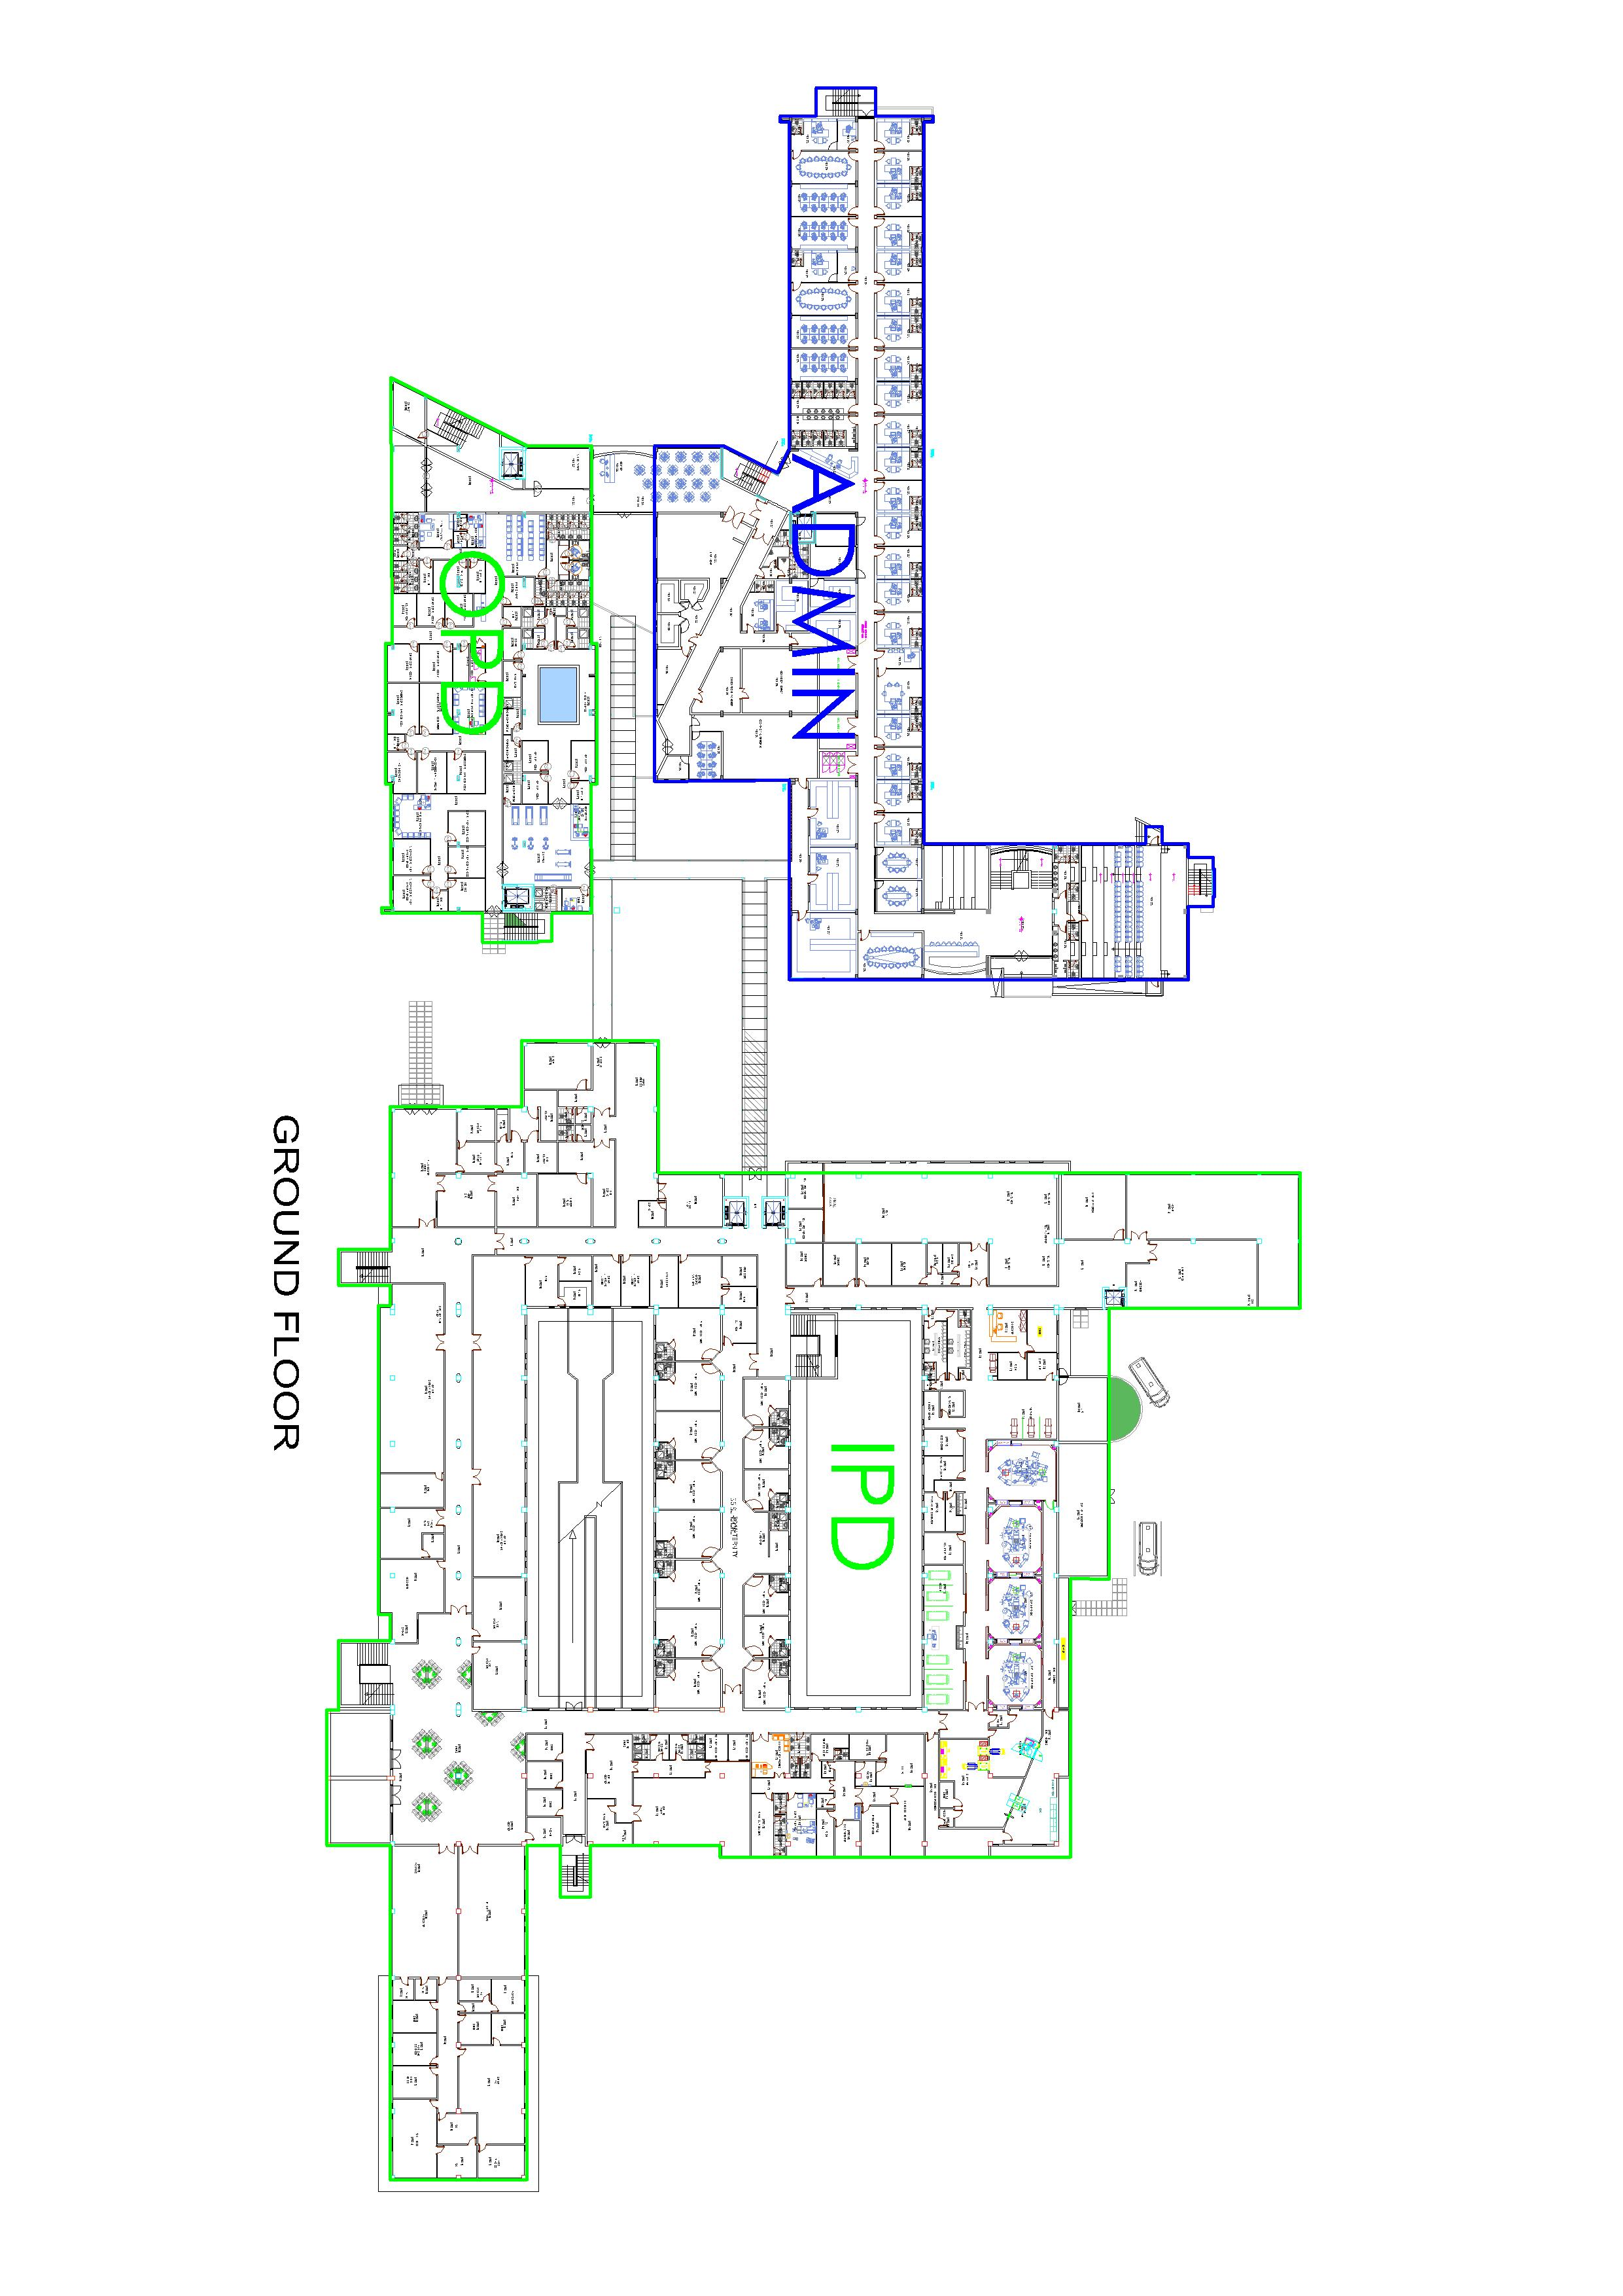
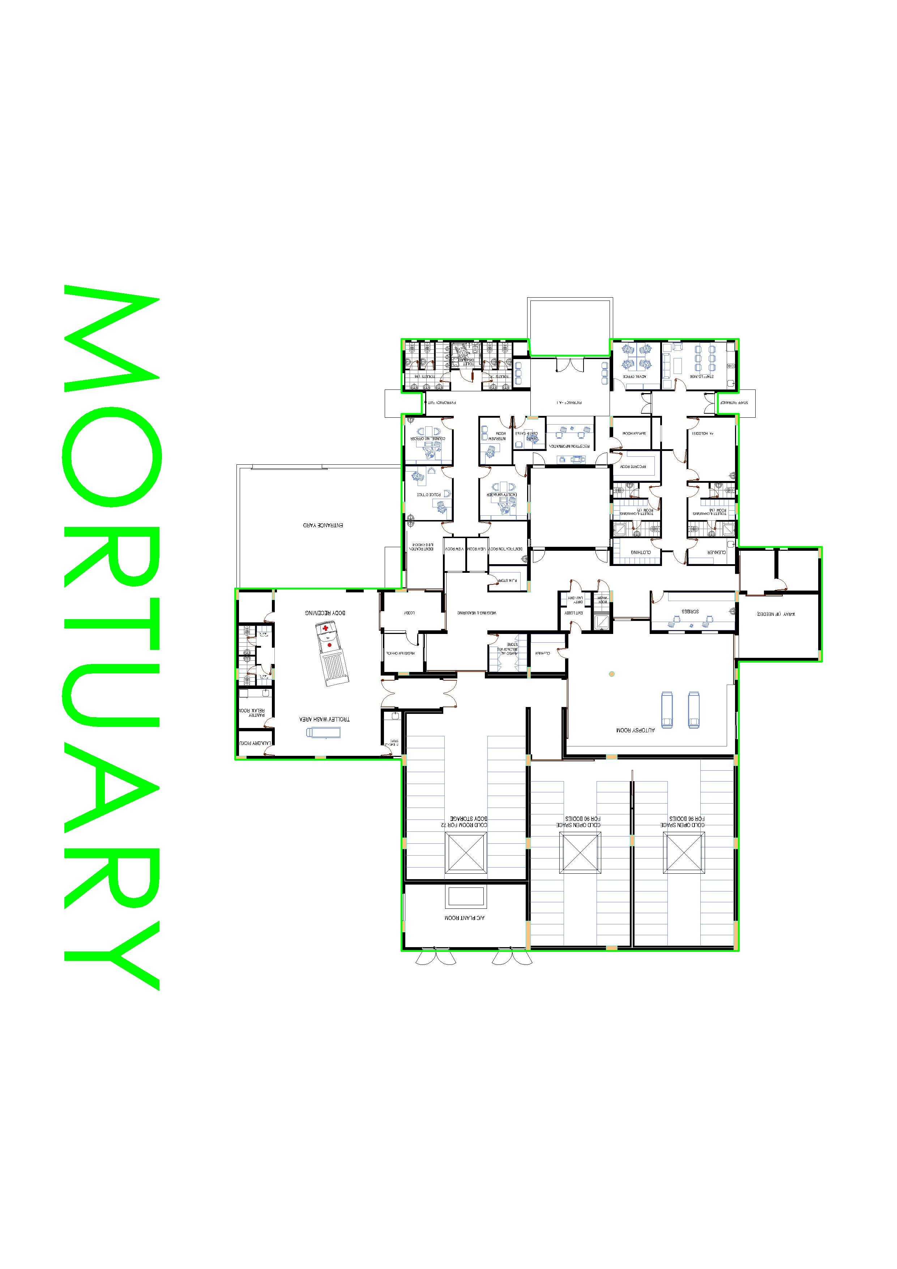
Phasing options
MORTUARY
Option 1
Included
OPD
IPD
MORTUARY
Excluded
ADMINISTRATIVE BLOCK
IPD
Legend
Excluded regions
Included regions
OPD
TANIT MEDICAL ENGINEERING
TANIT MEDICAL ENGINEERING January 2023

Slide 5
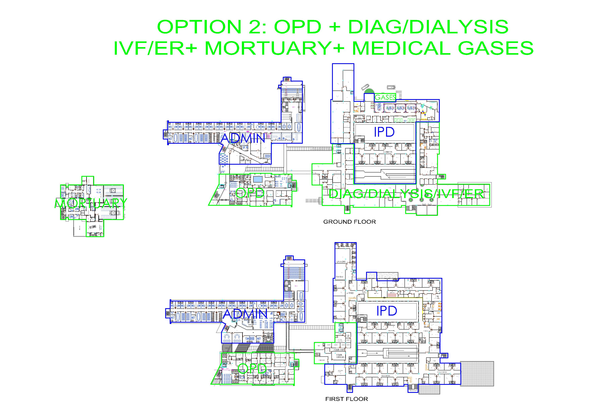
Phasing options
MORTUARY
Option 2
Included
OPD
IPD
Diagnostics
Dialysis
IVF
ER
Medical gases
MORTUARY
Excluded
ADMINISTRATIVE BLOCK
Portions of IPD
OPD
Diagnostic, Dialysis, IVF, & ER
Legend
Excluded regions
Included regions
OPD
OPD
TANIT MEDICAL ENGINEERING
TANIT MEDICAL ENGINEERING January 2023

Slide 6
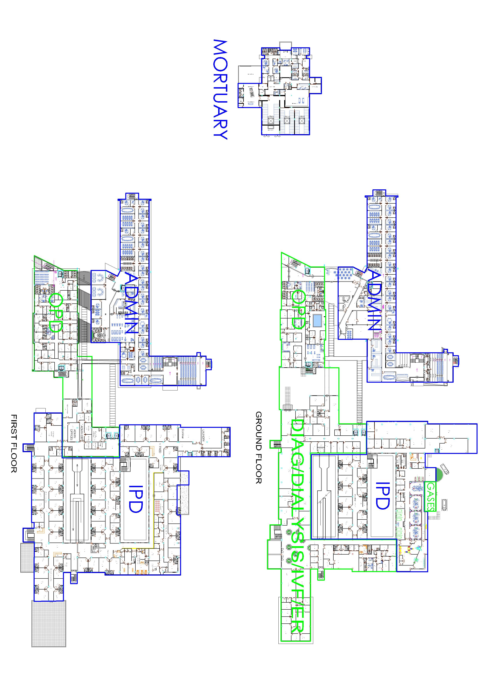
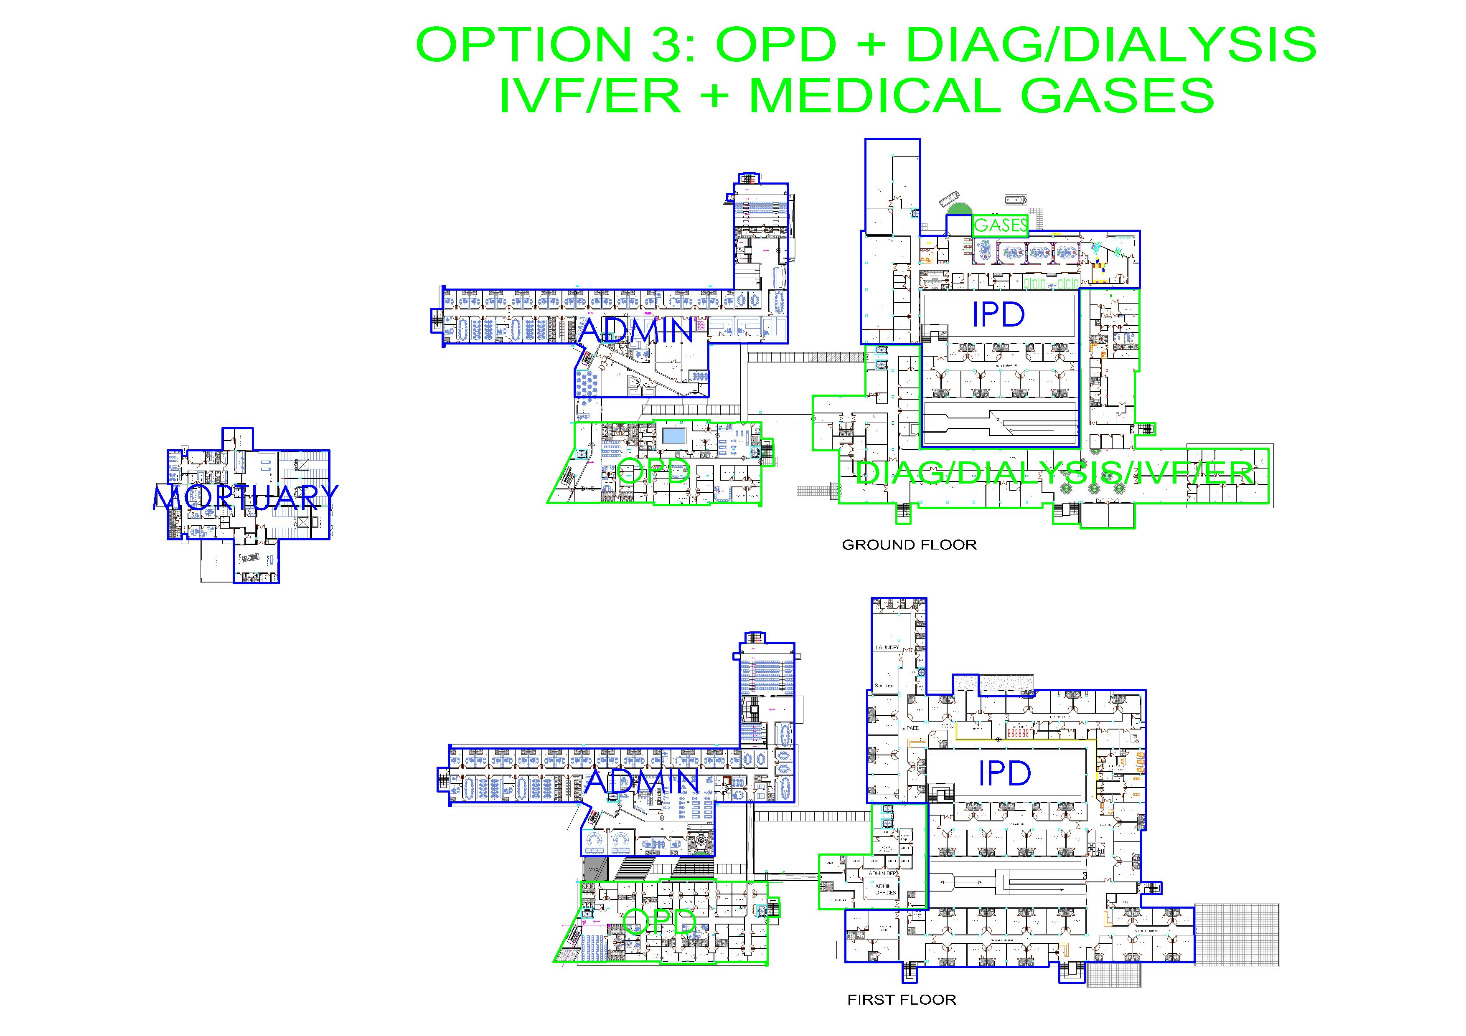
Phasing options
Option 3
Included
OPD
IPD
Diagnostics
ER
Medical gases
Excluded
ADMINISTRATIVE BLOCK
Portions of IPD
MORTUARY
OPD
Diagnostic, Dialysis, IVF, & ER
Legend
Excluded regions
Included regions
OPD
TANIT MEDICAL ENGINEERING
TANIT MEDICAL ENGINEERING January 2023

Slide 7
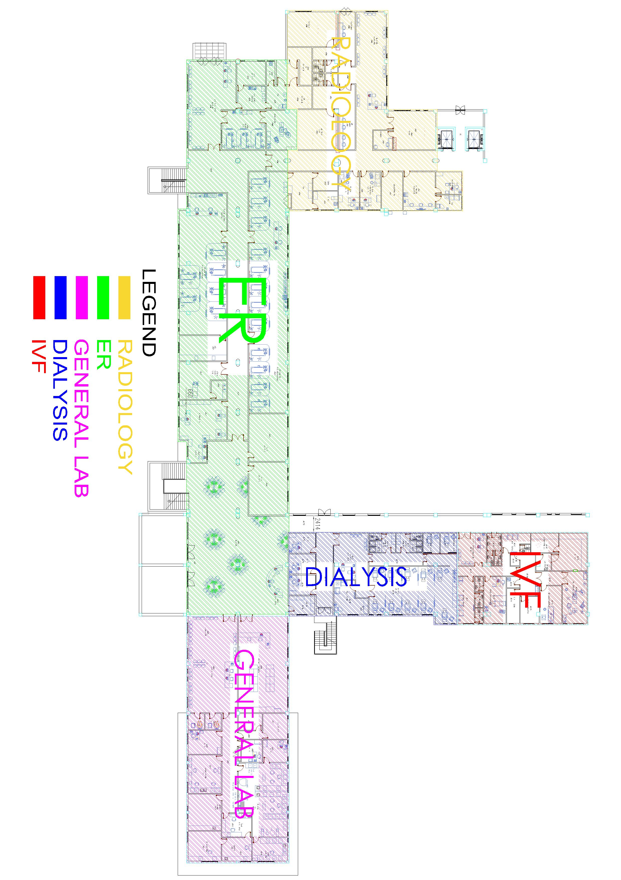
A Section of Option 3
TANIT MEDICAL ENGINEERING
TANIT MEDICAL ENGINEERING January 2023

Slide 8
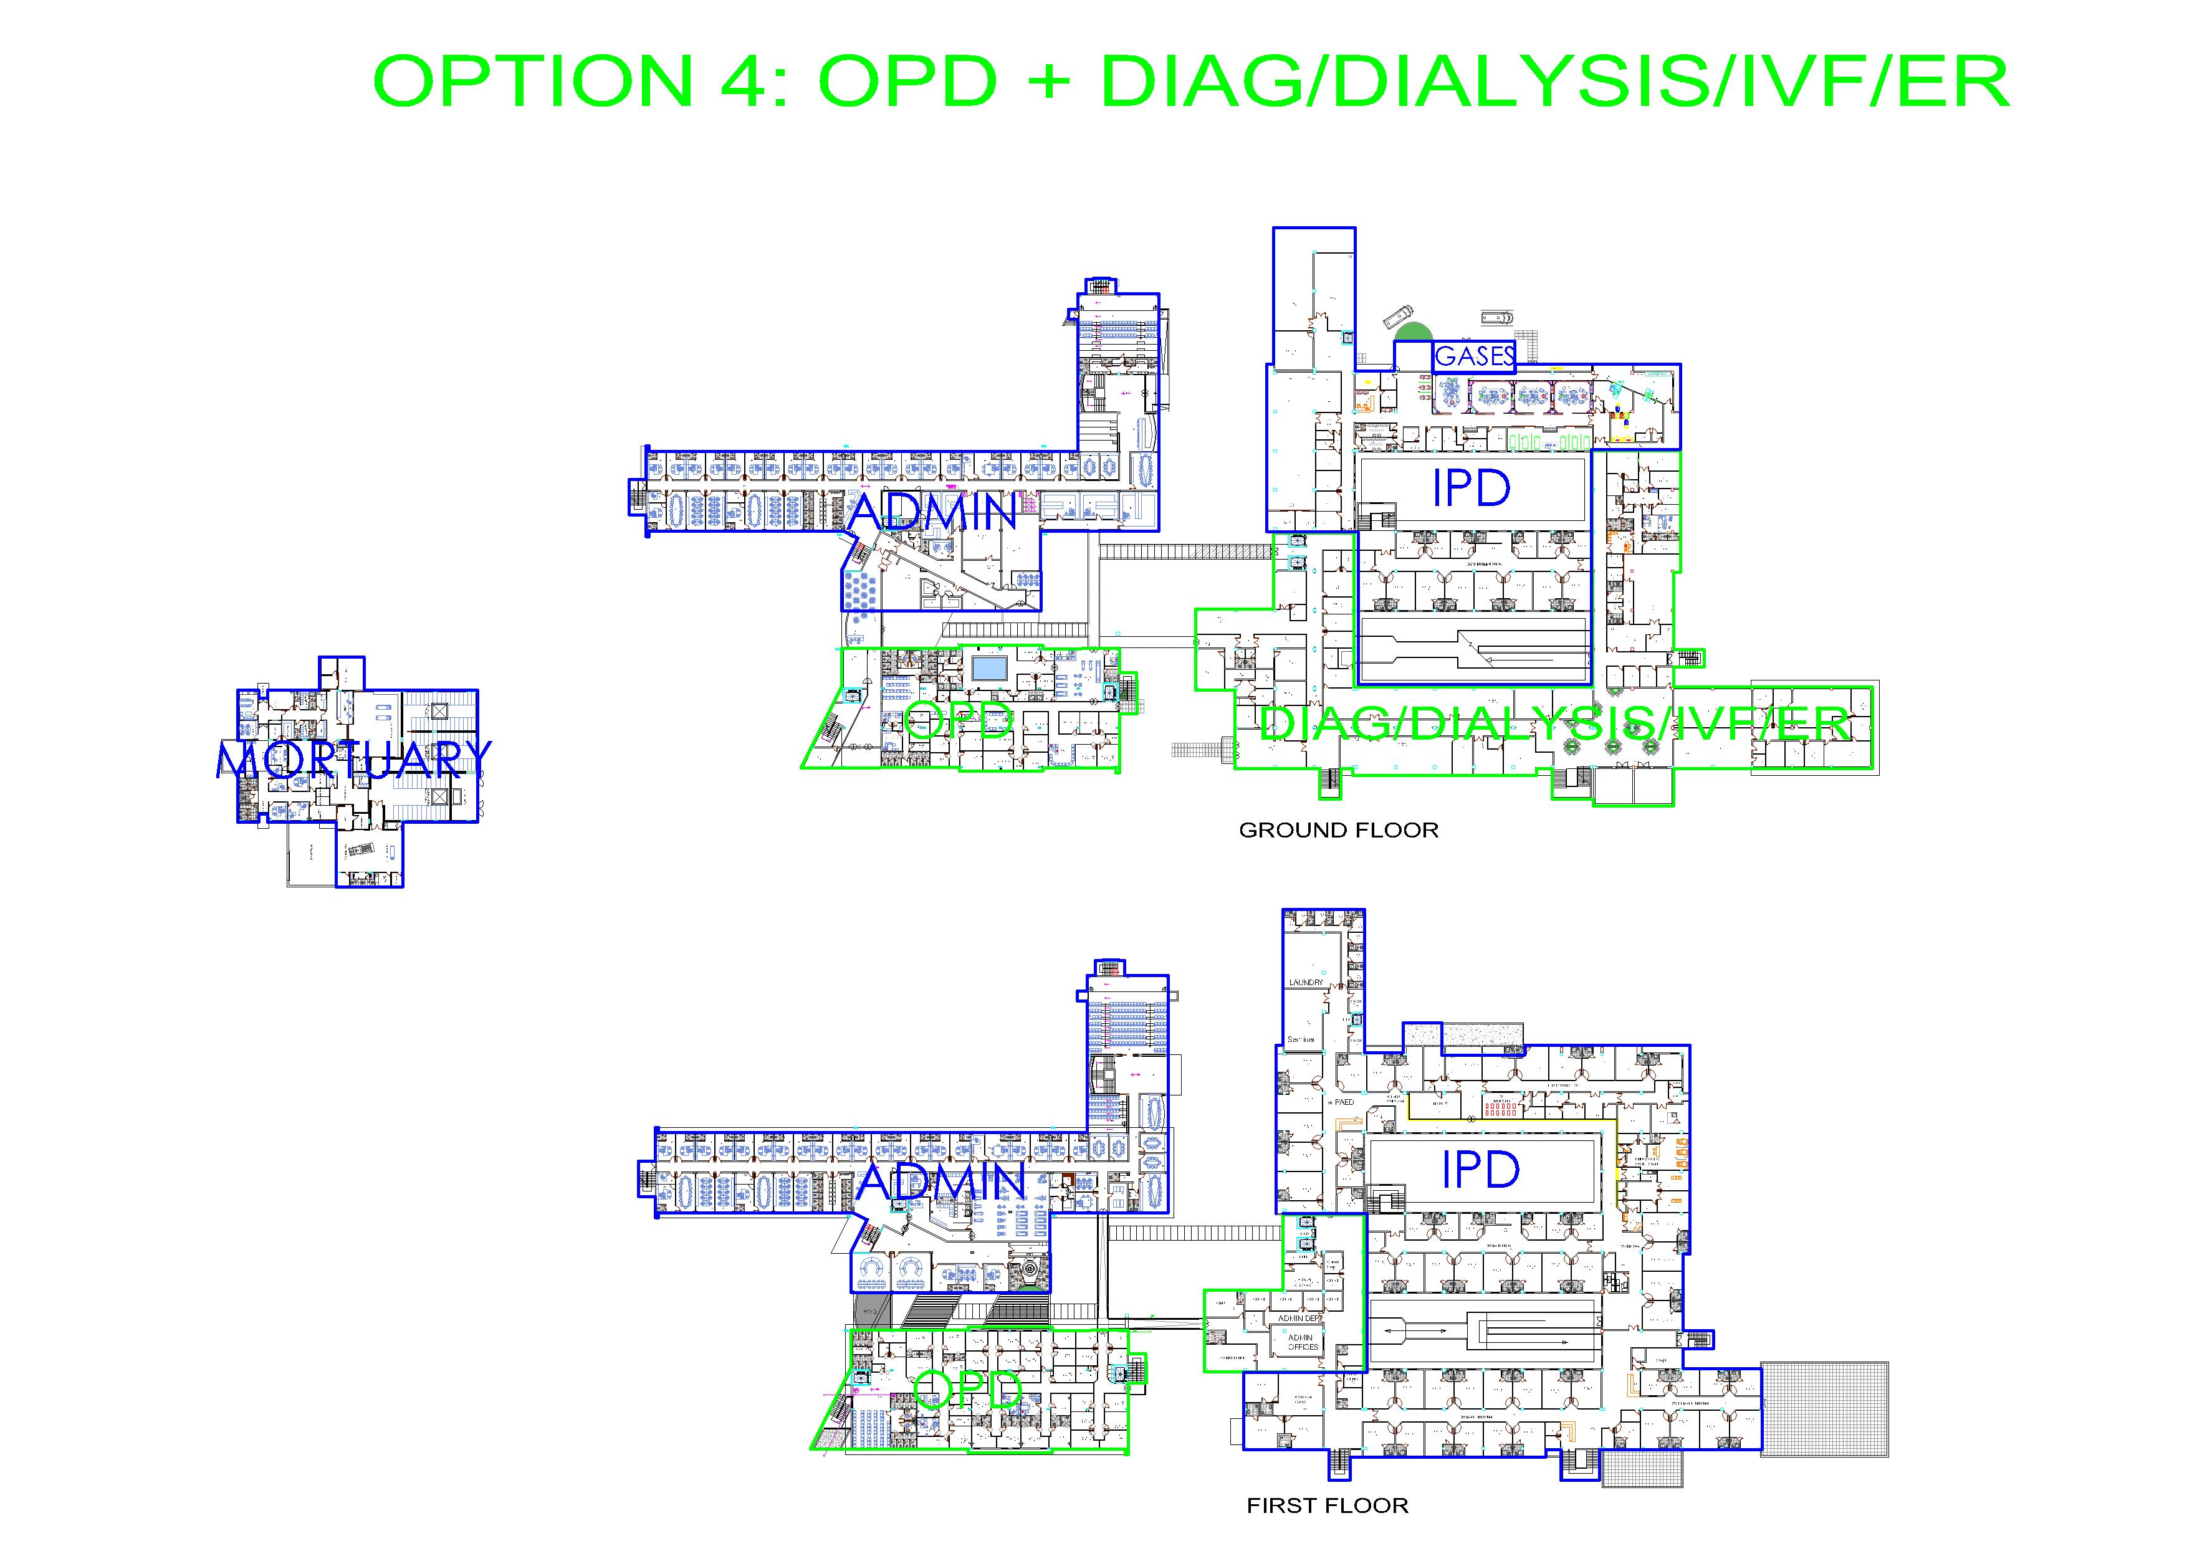
Phasing options
Option 4
Included
OPD
IPD
Diagnostics
Dialysis
IVF
ER
Excluded
ADMINISTRATIVE BLOCK
Portions of IPD
Medical gases
MORTUARY
OPD
Diagnostic & ER
Legend
Excluded regions
Included regions
OPD
TANIT MEDICAL ENGINEERING
TANIT MEDICAL ENGINEERING January 2023

Slide 9
General cost breakdown
 |  | STELLA OBASANJO HOSPITAL PHASE PLANNING
 |  |  | FULL PROJECT 9-12 MONTHS | Option 1 (9-12 months) | Option 2 (6-9 Months) | Option 3 (6-9 Months) | Option 4 (6-7 Months)
 |  | Description | FULL PROJECT WITH ADMIN | Full Project LESS ADMIN | OPD + DIAG/DIALYSIS/IVF/ER + MORTUARY + MEDICAL GASES | OPD + DIAG/DIALYSIS/IVF/ER + MEDICAL GASES | OPD + DIAG/DIALYSIS/IVF/ER
S/No. | CONTRACTOR | ITEMS
1 | A & K Construction Limited | OPD - Out Patient Department | 1,176,578,029.99 | 1,176,578,029.99 | 1,176,578,029.99 | 1,176,578,029.99 | 1,176,578,029.99
2 | A & K Construction Limited | IPD - In Patient Department | 3,129,724,081.10 | 3,129,724,081.10 | 1,877,834,448.66 | 1,564,862,040.55 | 1,564,862,040.55
3 | A & K Construction Limited | Administrative Block | 2,400,786,761.68 | - | - | - | -
4 | TO BE ADVISED - TBA | Mortuary (Estimate) | 250,000,000.00 | 250,000,000.00 | 250,000,000.00 | 0.00 | 0.00
 |  | SUB TOTAL - CONSTRUCTION | 6,957,088,872.77 | 4,556,302,111.09 | 3,304,412,478.65 | 2,741,440,070.54 | 2,741,440,070.54
 |  | Expected Construction Variation @10% | 695,708,887.28 | 455,630,211.11 | 330,441,247.87 | 274,144,007.05 | 274,144,007.05
 |  | Construction Total | 7,652,797,760.05 | 5,011,932,322.20 | 3,634,853,726.52 | 3,015,584,077.59 | 3,015,584,077.59
1 | SUDABELT MEDICAL CO. LTD | Lot 1 - Medical Equipment | 4,135,198,000.00 | 4,135,198,000.00 | 1,566,785,650.00 | 1,385,962,650.00 | 1,566,785,650.00
2 | SUDABELT MEDICAL CO. LTD | Lot 2 - Radiology | 2,104,552,000.00 | 2,104,552,000.00 | 2,104,552,000.00 | 2,104,552,000.00 | 2,104,552,000.00
3 | SUPREME MEDITECH LTD. | Lot 3 - Medical Gases | 648,989,222.31 | 648,989,222.31 | 648,989,222.31 | 648,989,222.31 | -
4 | SUPREME MEDITECH LTD. | Lot 4 - Mortuary | 129,241,980.00 | 129,241,980.00 | 129,241,980.00 | - | -
5 | SUDABELT MEDICAL CO. LTD | Lot 5 - Laboratory | 1,090,041,596.00 | 1,090,041,596.00 | 1,090,041,596.00 | 803,323,944.00 | 1,090,041,596.00
6 | REEDPRICEMAN | KITCHEN LAUNDRY TOOLS + FURNITURE | 339,472,422.50 | 339,472,422.50 | - | - | -
7 | BLUEHUB LTD | IT EQUIPMENT AND AUDIOVISUALS | 357,722,837.25 | 134,105,239.50 | 83,156,302.50 | 83,156,302.50 | 83,156,302.50
8 | SABTRAK LTD | APPLIANCES | 42,407,202.00 | 35,573,814.00 | 10,870,185.00 | 10,870,185.00 | 10,870,185.00
9 | REEDPRICEMAN | OFFICE FURNITURE | 1,492,211,413.00 | 809,369,069.50 | 429,106,298.75 | 429,106,298.75 | 429,106,298.75
 |  | EQUIPMENT AND FURNISHING SUB TOTAL | 10,339,836,673.06 | 9,426,543,343.81 | 6,062,743,234.56 | 5,465,960,602.56 | 5,284,512,032.25
 |  | Expected Equipment & Furnishing Variation@5% | 516,991,833.65 | 471,327,167.19 | 303,137,161.73 | 273,298,030.13 | 264,225,601.61
 |  | TOTAL EQUIPMENT AND FURNISHING COST | 10,856,828,506.71 | 9,897,870,511.00 | 6,365,880,396.29 | 5,739,258,632.69 | 5,548,737,633.86
 |  | SCENARIO TOTAL SUM | 18,509,626,266.76 | 14,909,802,833.20 | 10,000,734,122.80 | 8,754,842,710.28 | 8,564,321,711.46
 |  |  | DIFFERENCE | 3,599,823,433.56 | 8,508,892,143.96 | 9,754,783,556.48 | 9,945,304,555.30
 |  | EQUIPMENT PAYMENT PLAN
 |  | Initial Payment (15 days) 80% | 8,685,462,805.37 | 7,918,296,408.80 | 5,092,704,317.03 | 4,591,406,906.15 | 4,438,990,107.09
 |  | Next Payment (60 days) 10% | 1,085,682,850.67 | 989,787,051.10 | 636,588,039.63 | 573,925,863.27 | 554,873,763.39
 |  | Final Payment (Post Deployment) 10% | 1,085,682,850.67 | 989,787,051.10 | 636,588,039.63 | 573,925,863.27 | 554,873,763.39
 |  | This is excludes all Preoperational cost
 | APPROXIMATE ESTIMATED COST OF MORTUARY
 | Total floor area of OPD IS 2,458
 | Total contract sum of OPD IS 1,176,578,029.99
 | Cost per m2 cost/are= N478,672.92
 | TOTAL FLOOR AREA OF MORTUARY SHOULD BE NO MORE THAN 550 M2 |  | TO BE REDESIGNED
 | Utilizing average cost Per Sq. metre of N445,545.00
 | This gives - N454,545.00 x 550 = N 250,000,000.00
 | Cost of constructing mortuary is N 250,000,000 - Estimated
FULL PROJECT
(WITH ADMINISTRATIVE BLOCK)
₦19,026,618,100.41
Phase
TANIT MEDICAL ENGINEERING
TANIT MEDICAL ENGINEERING January 2023

Slide 10
Preferred option
We strongly advice option 3 as it falls in line with setting the stage for a quick completion of the project later on,
As well as being able to function and generate funds immediately.
FULL PROJECT
(WITH ADMINISTRATIVE BLOCK)
₦18,509,626,266.76
Phase
OPTIONS | SCENARIO TOTAL SUM (₦) | DIFFERENCE (₦) | SCENARIO COVERAGE AREAS
OPTION 3 | 8,754,842,710.28 | 9,754,783,556.48 | OPD,IPD(DIAGNOSTIC, ER AND MEDICAL GASES), BUT EXCLUDING ADMINISTRATIVE BLOCK , ALL OTHER PORTIONS OF IPD, AND MORTUARY
TANIT MEDICAL ENGINEERING
TANIT MEDICAL ENGINEERING January 2023

Slide 11

End of Presentation
A big thank you from all of us
at
Tanit Medical Engineering
₦19,026,618,100.41
TANIT MEDICAL ENGINEERING
TANIT MEDICAL ENGINEERING January 2023

